Slide 1
Joe A. Ables DVM, MA
White-tailed Deer Vaccinations???

Slide 2
Joe A. Ables, D.V.M, M.A. drjoeables@yahoo.com
B.S. : Texas A&M University 1995
Biomedical Science
Animal Science
M.A. : Texas A&M University 1998
Animal Science
Reproductive Physiology
Nutrition
D.V.M : Texas A&M University 2002

Slide 3
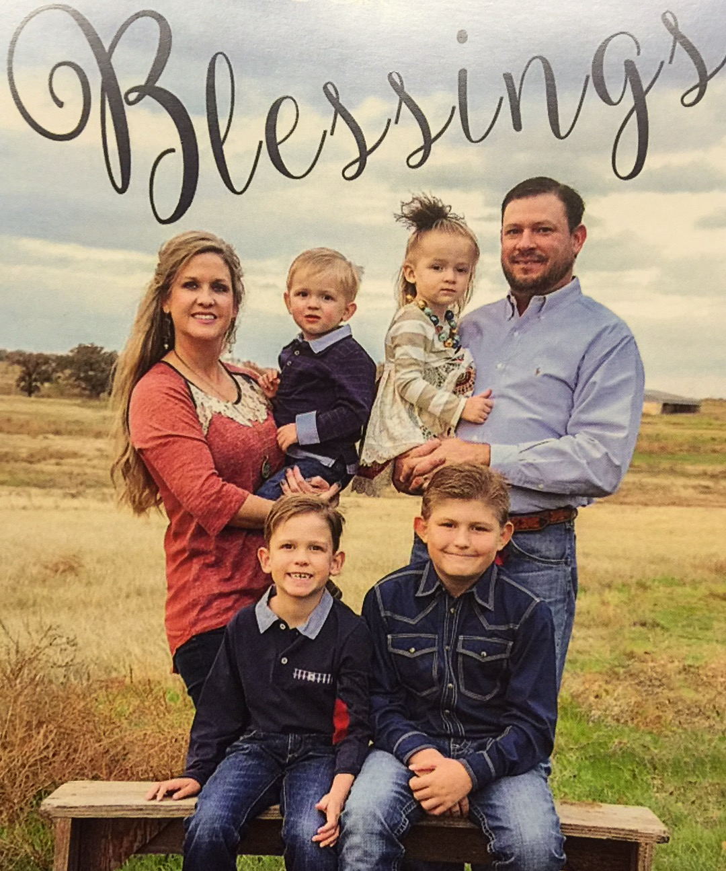

Slide 4
Are You Ready ???

Slide 5
Vaccinations 101
Why vaccinate?
When Do We Vaccinate?
What diseases are important ?
IM vs SQ
Questions ???

Slide 6
Why Vaccinate ???
Boost Immune system
Insurance
Increase antler growth
Propagate numbers
Decrease Veterinarian/Drug costs

Slide 7
When Do We Vaccinate ???
What is your Program
Lap AI
Bottle Raising Fawns
Facilities ???
Chute vs. darting
Fall
Prep for A.I.
Spring
Post Rut

Slide 8
What Diseases are Important???
Bacterial
Viral
Reproductive

Slide 9
Vaccines- Bacterial
Covexin 8
Black Leg
Tetanus
Enterotoxemia
2.5 cc SQ
Once a year
Boosters on fawns
Mix w 2.5 cc Virashield 6

Slide 10
Vaccines- Bacterial
Presponse
Pasturella Haemolytica and multocida (Manheimia)
1cc in muscle
Pre-breeding and Post-rut
MOST IMPORTANT !!!
Mix w fuso, clostidium A, or staybred

Slide 11
Vaccines- Bacterial
Fusogard
Anaerobic bacteria- commonly found in GI tract
Foot Rot
Trench mouth
1cc in muscle
When?
Mix w presponse, staybred, clostridium A

Slide 12
Vaccines- Bacterial
Clostridium Perfringes Type A
“Silent Killer”
Difficult to manage/treat
1 cc in muscle
Signs – “skin and bone”
“Spring vaccine”
Mix w presponse, fuso

Slide 13
Vaccines- Viral
Vira-Shield 6+Somnus
IBR, BVD, BRSV, PI3 + Haemophilus somnus
2.5cc in muscle
Mix with Covexin 8
Once a year
Prior to shipment
Sales
Breeding

Slide 14
Vaccines- Viral
EHD
Epizootic Hemorraghic Disease
Various Autogenous Vaccines
No Efficacy Studies
No Increase in SN titers

Slide 15
Vaccines- Reproductive
Staybred VL 5
Leptospirosis
Vibriosis
1cc in muscle
Prevent EED- Early Embryonic Death
Increase conception rates
Prevent Abortions
Mix with presponse, fuso

Slide 16
SQ vs IM
Subcutaneous-SQ
Under the skin
Difficulty administering under the skin
Intra-Dermal Abscesses
Two-handed injection takes longer
More likely to react
Intramuscular- IM
Easy to administer
Abscesses less likely
less likely to react
Location
Rump vs. Neck

Slide 17
Food for Thought..
What age do we start vaccinations ?
Boosters?
SQ vs. IM ?
Time of year ?
Prevalence of Disease
Endemic Areas?

Slide 18
Normal Core Routine Fall Vaccines
Covexin 2.5 cc IM
Virashield 2.5 cc IM
Staybred VL5 - 1cc IM
Fusogard 1cc IM
Presponse 1 cc IM

Slide 19
Normal Core Routine Spring Vaccines
Covexin 2.5 cc IM
Virashield 2.5 cc IM
Fusogard 1cc IM
Presponse 1 cc IM
Clostridium A 1cc IM

Slide 20
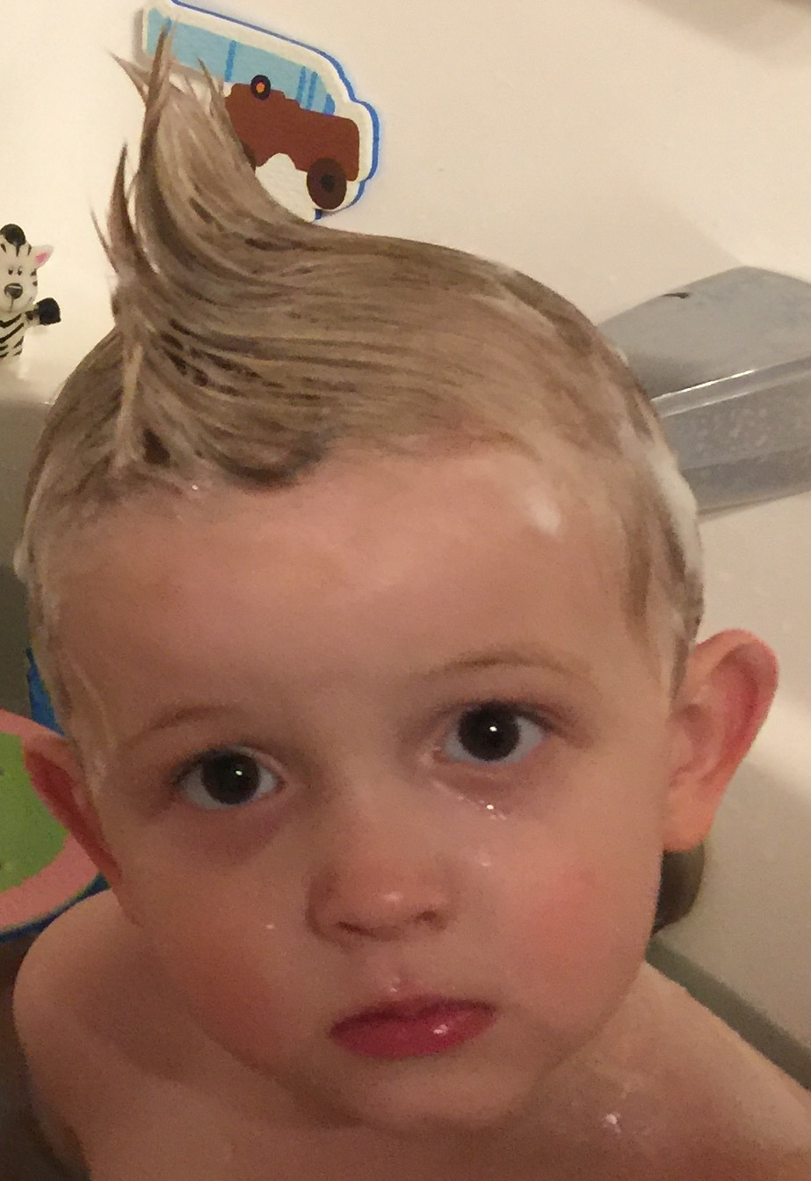
Questions ???

