Slide 1
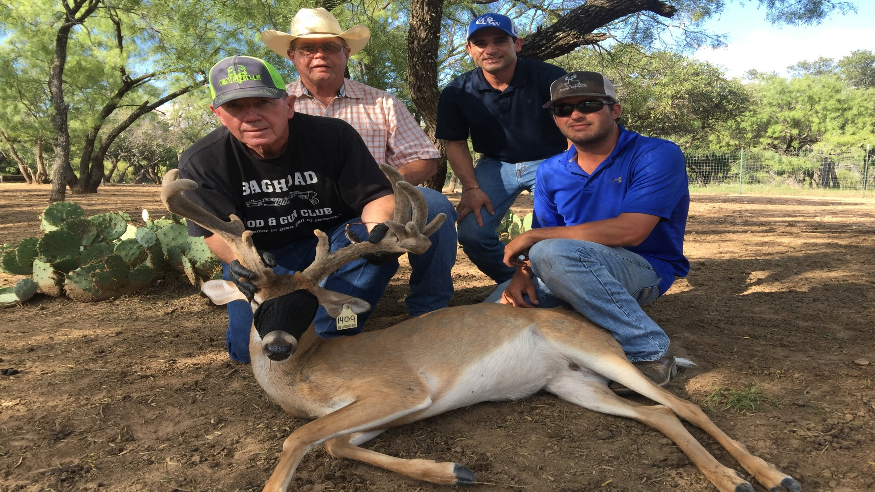
Common Foot/ Leg Problems

Slide 2
Overview
Common Infections
Foot
Leg
Mouth
Causes
Etiological agents
Prevention
Treatment
Antibiotics used

Slide 3
Necrobacillosis
Common Bacterial Isolate
Fusobacterium necrophorum
Locations:
Foot and lower limbs
“Foot Rot”
Mouth and mandible
“Trench mouth”

Slide 4
Fusobacterium Necrophorum
Anaerobic bacteria
Commonly found in GI tract
Cases increase as fecal contamination builds up
Difficult to manage ???

Slide 5
Causes of Foot Rot
Trauma
Most common lameness in deer
Environmental
Wet environment
Crowded pens- fecal contamination
Snake Bites

Slide 6
Treatment : Preventative vs Medical/ Surgical
Preventative
Pen management
Prevent overcrowding
Lyme the pens
Vaccination
Fusogard- 1 cc IM

Slide 7
Treatment of Foot Rot
Medical
Interdigital space injection
Tetradure 5 cc per 100lbs IM
Regional Perfusion
Naxcel- 5 cc per 100 lbs
Bandaging
Epsom salt / iodine

Slide 8
Regional Perfusion
Digital artery
10 minutes
5 cc Naxcel per 100 lbs
Unresponsive Cases
Sodium Iodide
12cc per 100 lbs IV

Slide 9
Surgical Treatment
IMPORATANT !!!
Radiograph if no response after 1st treatment (7 days)
Portable/Digital Radiograph unit
Surgical Debridement
Digit Amputation
Use PDS suture only

Slide 10
Necrobacillosis of the Mouth
Commonly affects fawns
Responds great to Tetradure at 0.5 cc per 10 lbs im
“Trench mouth”
Refractory Cases
Na I- 0.6 cc per 10 lbs iv and retreat in 14 days (Fawn dosage)

Slide 11
Lower Limb Infections
Seen in all ages
More commonly in fawns
Causes
Cactus needles
Snake bites
Etiologic Agents
Nocardia spp, Mycobacterium spp, Actinobacillus spp

Slide 12
Treatment
Surgical :
Difficult to treat
Lance and flush with chlorhexidine
Keep open and expose to oxygen- Hyperbaric chamber???

Slide 13
Antibiotics
Baytril
Fawns- 10 lbs
22mg taste tabs PO BID x 21 days
Adults- 5-10 mg/kg
Sodium Iodide
Good Bone Penetration
12 cc per 100 lbs IV and retreat in 14 days

Slide 14
Food For Thought

Slide 15
Common Foot and Mouth Problems
Etiologic Agent
Fusobacterium necrophorum
Prevention
Vaccinate with Fusogard- 1 cc IM (all deer)
Treatment
Tetradure- 5 cc per 100 lbs IM
Na I- 12 cc per 100 lbs IV repeat in 2 weeks

Slide 16
Leg Problems
Etiologic Agent
Actinomycetes spp
Nocardia
Mycobacterium
Actinobacillus
Treatment
Lance and Flush, allow Oxygen contact
Baytril (5-10 mg/kg) IM and Na I

Slide 17
Other Antibiotics for Lower limb infections
Uniprim
1 scoop per 1100 lbs
Nuflor
3cc per 100 lbs
Excede
3 cc per 100 lbs
Chlortetracycline in feed

Slide 18
Questions ???

