Slide 1
PNEUMONIA
IN
DEER

Slide 2
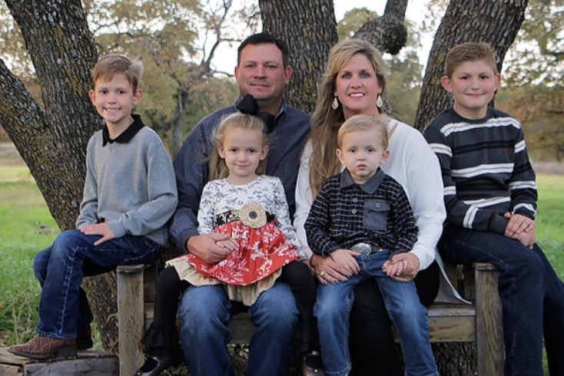
Ables Family
The Ables Family

Slide 3
Education
Joe A Ables, DVM, MA
drjoeables@gmail.com
B.S. : Texas A&M University 1995
Biomedical Science
Animal Science
M.A. : Texas A&M University 1998
Animal Science
Reproduction Physiology
Nutrition
D.V.M : Texas A&M University 2002

Slide 4
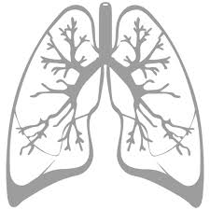
Overview
Respiratory System
Anatomy
Function
Pathophysiology of Pneumonia
Pulmonary Defenses
Causative Agents
Types of Pneumonia
Lobar
Bronchopneumonia
Prevention
Treatment
Questions

Slide 5
Respiratory system
ANATOMY
Lungs
Parenchyma- Functional Tissue
Stroma- Supporting Tissue
Trachea – “Windpipe”
Ciliated columnar epithelium
Goblet cells
Bronchi
2 main Branches into the lungs
Resident Communal Bacteria
Bronchioles
Dilation/Constriction of small airways
Alveoli
Major part of Oxygen Exchange

Slide 6
Respiratory System
FUNCTION
1. Breathing- Oxygen in and CO2 out
Fresh Oxygen and expels waste CO2
2. Sound
Grunts, Snort Wheeze, Communication
3. Smell
Locating food, Heat detection- “Flehmen Response”

Slide 7
Pathophysiology of Pneumonia
Normal Defenses
Ciliated Columnar Epithelium
“Mucociliary Escalator”
Mucus – Goblet Cells
Immunoglobulin A- IgA
Alveolar Macrophages
Pneumonia – Causative Agents
Bacteria – Pasturella, Haemophilus, Staphylococcus,
Mycoplasma
Viruses – IBR, BVD, PI3, BRSV
Infectious Bovine Rhinotracheitis, Bovine Viral Diarrhea,
ParaInfluenza, Respiratory Syncytial Virus
Fungus- rare (immunocompromised)

Slide 8
Trachea
Pulmonary Defense
Epithelial lining
Ciliated Columnar Cells – Mucociliary escalator
Goblet cells – Produce Mucus
Immunoglobulin A (IgA)
natural surface protection
Communal Microflora
Bacteria, fungi, Viruses ?? (yes)

Slide 9
Bronchioles
Dilation/Constriction
Maintain an open airway
Oxygen (O2) enters the alveoli/bloodstream
Carbon Dioxide (CO2) to exit/ exhalation
Vital Role
Damage prevents O2/CO2 exchange
Impairs breathing
Respiratory alkalosis and systemic acidosis
Consolidation of lung region

Slide 10
Alveoli
Critical Portion of Respiration
Pulmonary Defense
Alveolar macrophage
Epithelial lininig- prevents fluid leakage
Site of gas exchange (O2 and CO2)

Slide 11
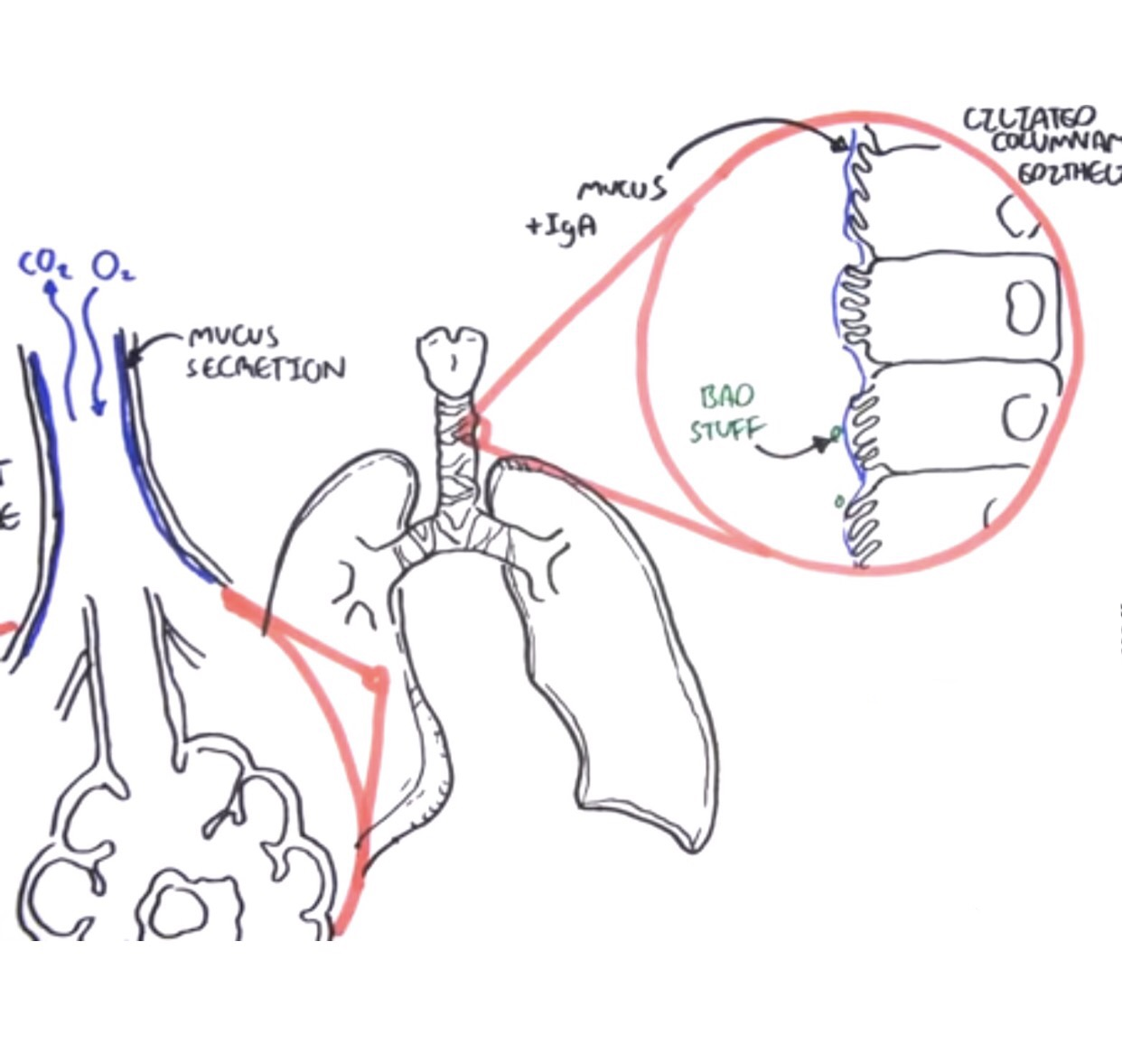
PULMONARY
DEFENSES

Slide 12
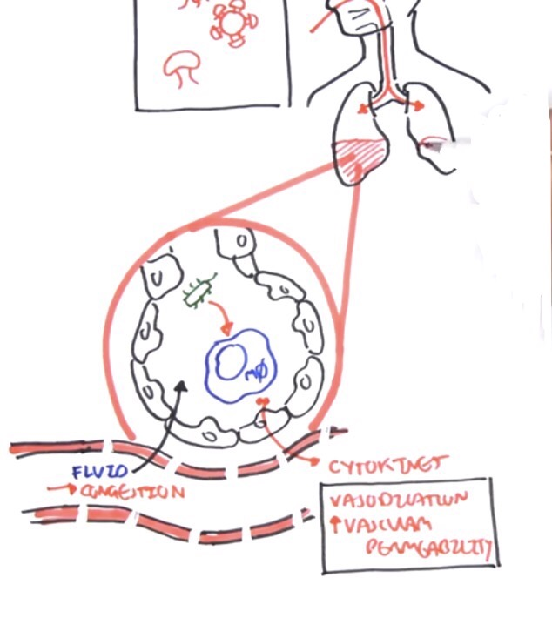
PULMONARY
DEFENSES

Slide 13
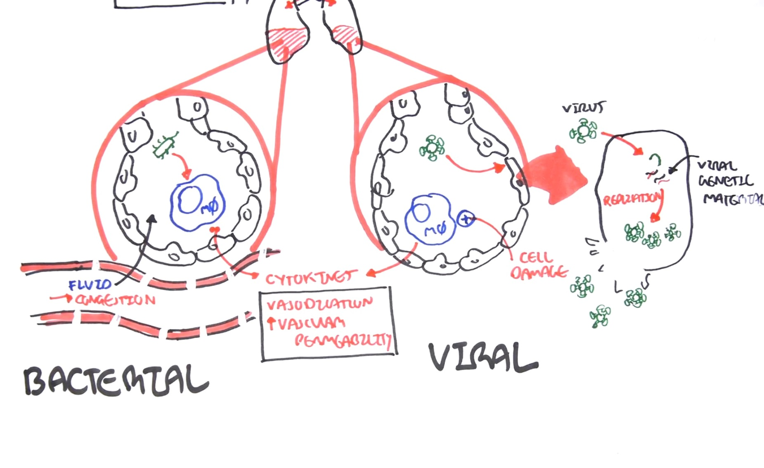
PULMONARY
DEFENSES

Slide 14
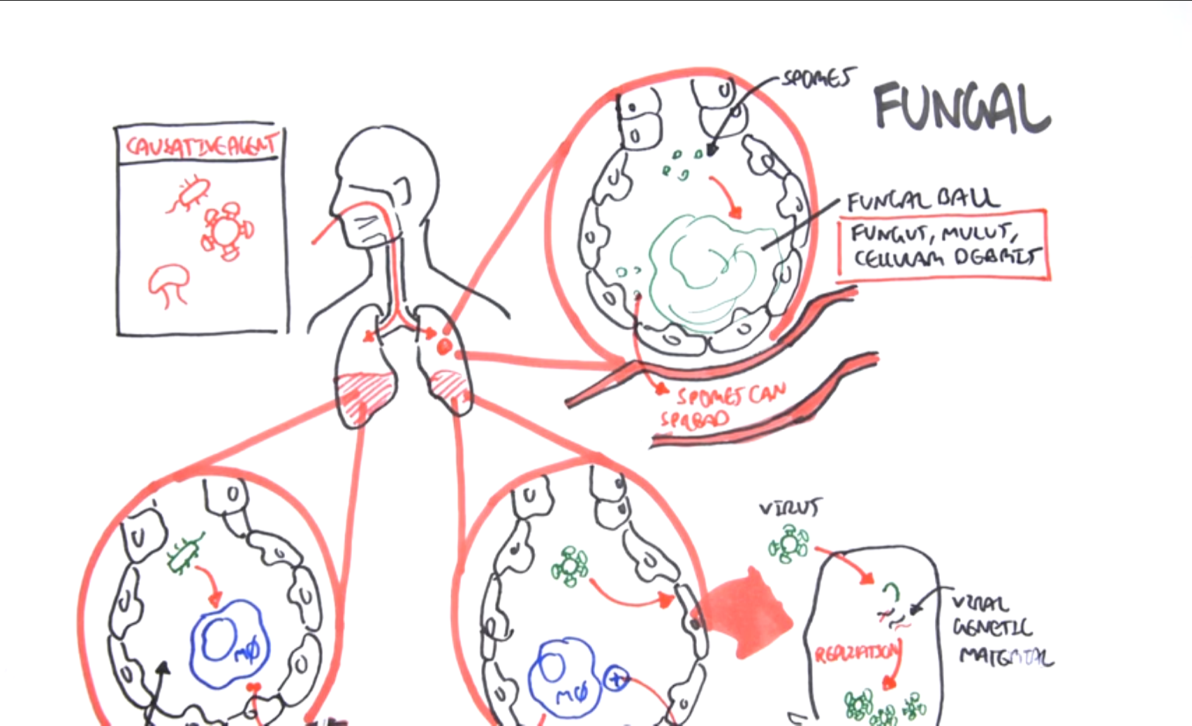
PULMONARY
DEFENSES

Slide 15
Types of Pneumonia
LOBAR
BRONCHOPNEUMONIA
Distal to Proximal
Proximal to Distal

Slide 16
Prevention
Vaccinations
Presponse HM
Virashield 6 + HS (Haemophilus somnus)
Prevent Overcrowding
8-10 deer per acre
Soil Treatment- Chronic usage
Lyme pens
Rotate Pens

Slide 17
treatment
Antibiotics
Type of Infection
Duration of Infection
Consult Veterinarian
Supportive Care
Diuretics- wet coughs
Clinimix- TPN
Immune Stimulants
EquiStim - IV
Vitamins/Minerals
Nebulizer

Slide 18
Questions ???

